Slide 1
City of Kavala

Slide 2
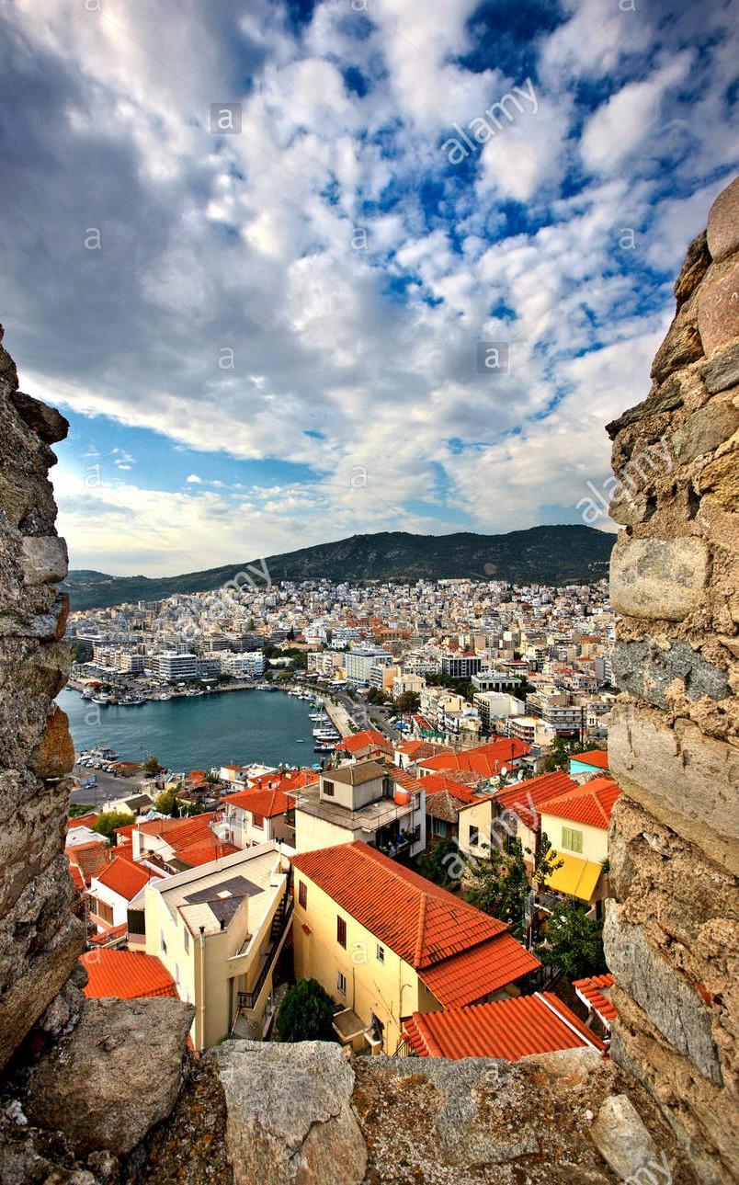
Introduction
Kavala is a city of the prefecture of Eastern Macedonia in northern Greece.
The population of the city reaches 54,000.
The history of the city dates back to Prehistoric times and extends to this day.
Crystal clear waters, cultural heritage sites, dreamy view, Mediterranean cuisine, leisurely strolls, short trips to nearby island Τhassos, picturesque villages and mountains.
Built amphitheatrically next to the sea, Kavala, a city at the crossroads between East and West, reflects the Greek experience and invites you to explore it.
The combination of our culture, region, customs and traditions give a satisfactory result, that inspired lots of poets, painters and singers nowadays.

Slide 3
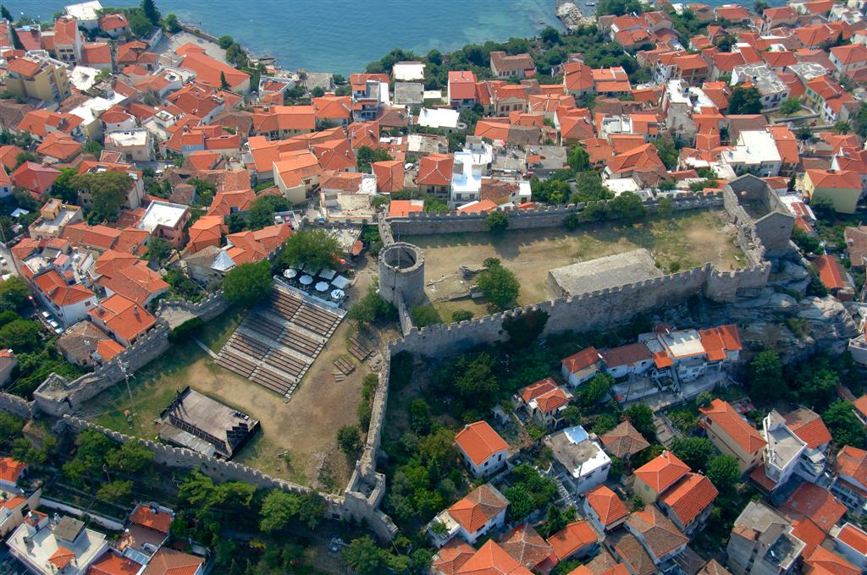
Kavala Fortress and the Old Town
Kavala fortress stands on a rocky hilltop and used to be the defender of the city.
Its walls and the central round tower are key features of the castle.
The largest part of the fortress was built in the first quarter of the 15th century on the ruins of the Byzantine acropolis.
Around the Fortress is Panagia, the charming old town with many nice old houses, restaurants and shops.

Slide 4
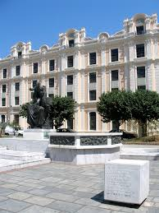
The Municipal Tobacco Warehouse
The Warehouse was built in the first decades of the 20th century for a Turkish tobacco merchant.
It is a fine example of Ottoman neoclassicism using elements of the baroque style such as the imposing top piece on the roof featuring four crowns.

Slide 5
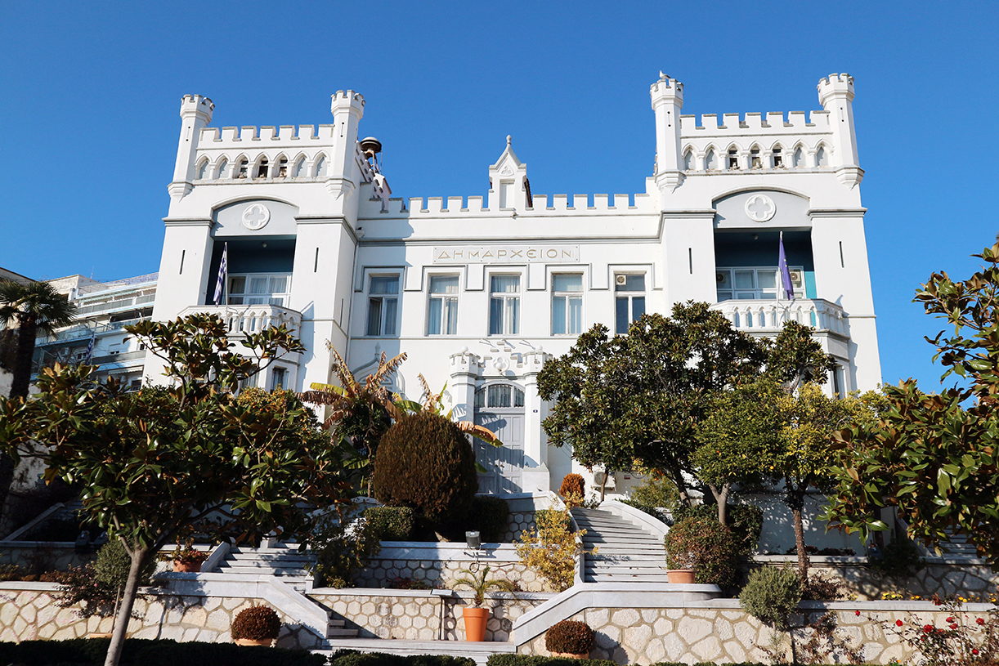
The Town Hall
The building is a miniature version of a Hungarian castle
Built in circa 1895 by the Hungarian tobacco merchant , Pierre Herzog.

Slide 6
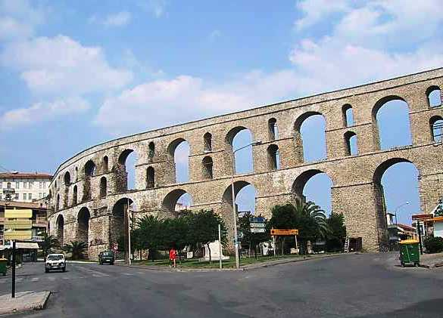
The Aquaduct ‘’Kamares’’
The most famous historical monument and an integral part of the old town, is the Kamares.
This is an extensive water supply system that was built by Suleiman the Magnificent to supply water to the barren rocky Panagia peninsula.
This grandiose creation is 280 m long and consists of 60 arches in four different sizes built on the site of the long wall which Emperor Andronicus II Paleologus had built.

Slide 7
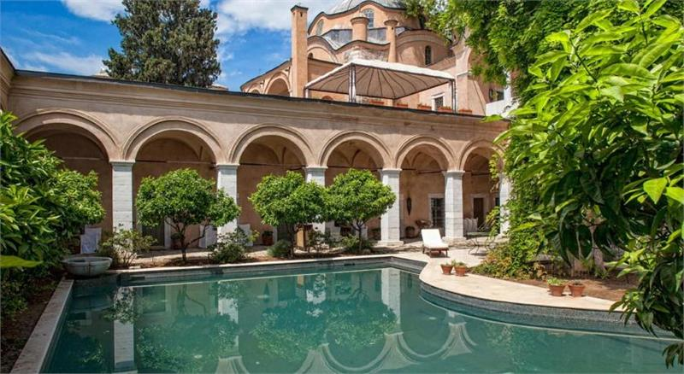
The Imaret
This large complex from the late Ottoman period is a classic example of Islamic architecture and almost the only one to have survived intact in the city.
It was built between 1817 and 1821 by the founder of the last Egyptian dynasty, Mohammed Ali.
The last years it has been a luxury hotel.

Slide 8
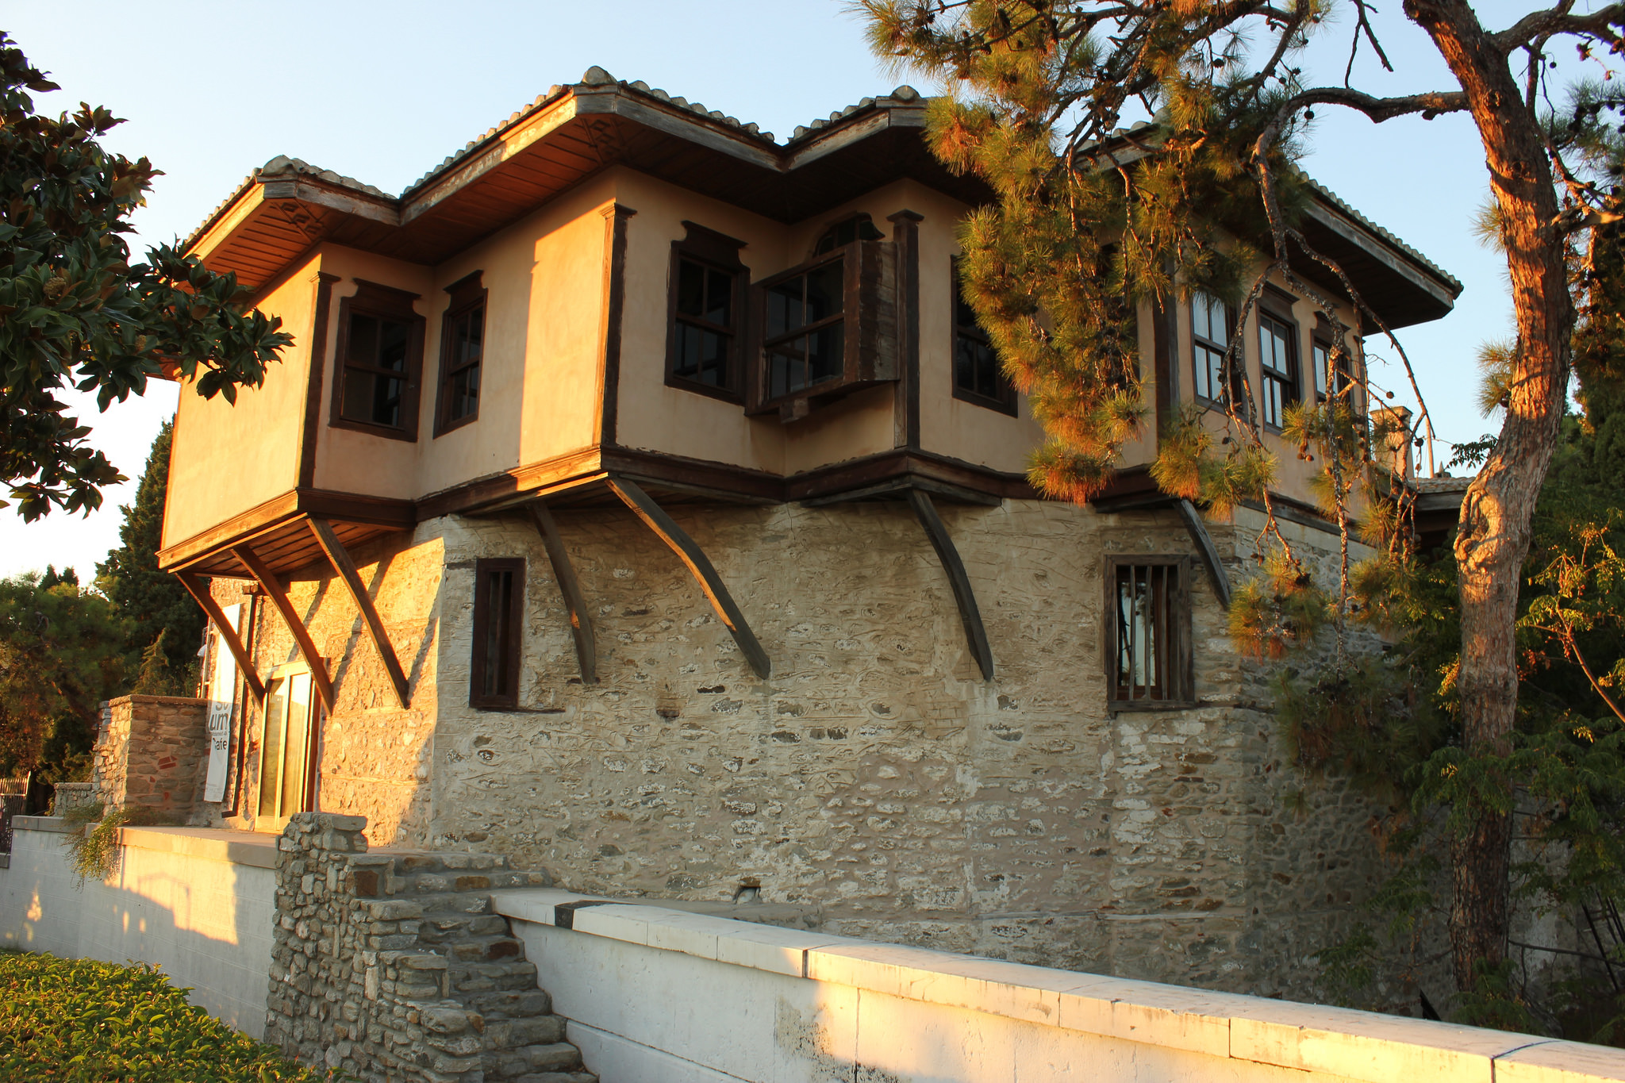
Mohammed Ali’s ‘’Konak’’
On the left-hand side of Mohammed Ali’s square is a house, known as locally Mohammed Ali’s ‘’Konak’’.
It is one of the largest and best designed mansions in the Panagia.

Slide 9
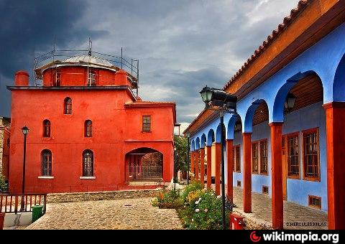
The old music of Halil Bey
Assending towards the castle through Mohamed Ali Street, you will come across the “Old Music of Halil Bey”.
This includes Halil Bey Mosque which dates from the beginning of the 20th Century built on an Early Cristian Basilica and a medrese.

Slide 10
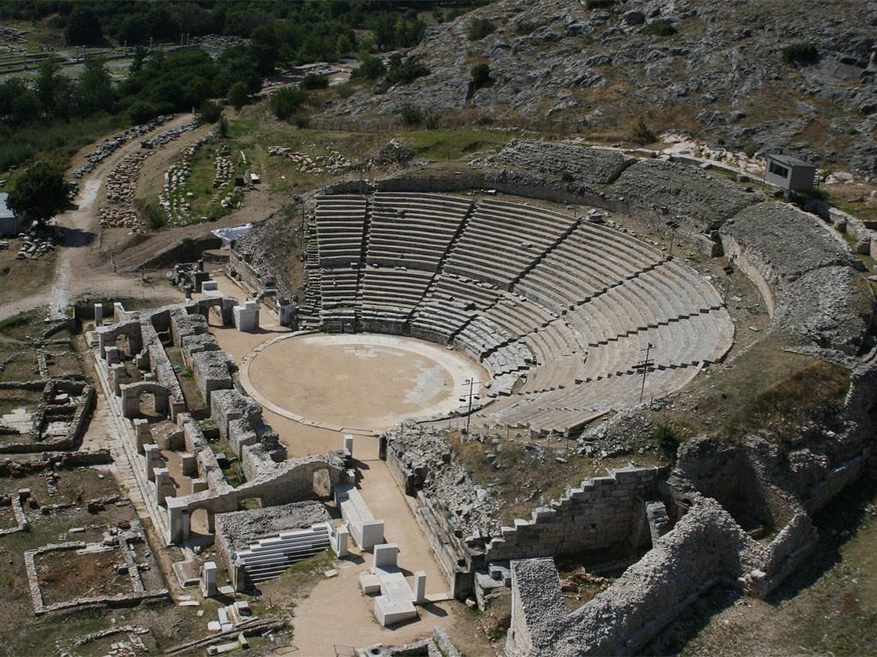
Philippi
The region of Kavala: prehistoric rock paintings, prehistoric settlement, important stop on the ancient Via Egnatia.
This is the place where Apostle Paul founded the fist Christian church in Europe, the largest center for tobacco processing and exporting in the Balkans.
Come and discover its fascinating history.
A visit to the archeological site of Philipi, an UNESCO World Heritage site is a must!

Slide 11
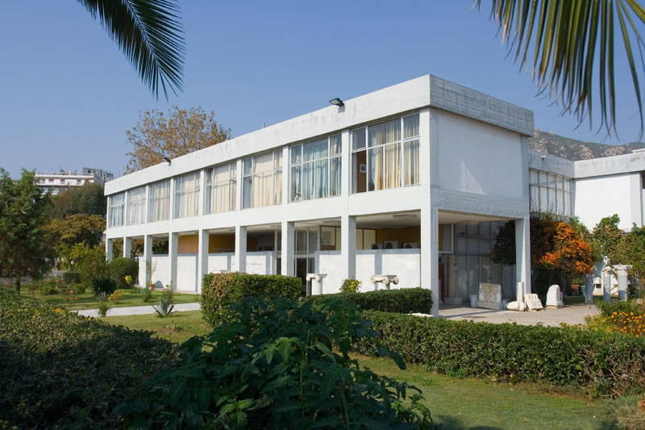
The Archeological museum
The items on display include objects made of stone and clay from Neolithic period and the bronze age.
The largest part of the museum is taken up by the new exhibition entitled “Neapolis Christoupolis Kavala” which presents the history of the town over time from antiquity to the present day via its monuments

Slide 12
BEACHES
Kavala has more than 80 km of Beaches available for swimming.
These are two of the most popular Beaches of Kavala.
Batis Beach
Batis is a beach just 5 km away from the city centre.
The beach has on-beach services and showers, changing rooms, a restaurant and two bars.
They are awarded with the “blue flag”.
Ammolofi Beaches
Ammolofi beaches are maybe the most popular beaches of Kavala and Greece, just 18 km from the city centre.
They are awarded with the “blue flag”.
The clear water is surrounded by the beautiful, exotic landscape of the beautiful of the coasts of Ammolofi.

Slide 13
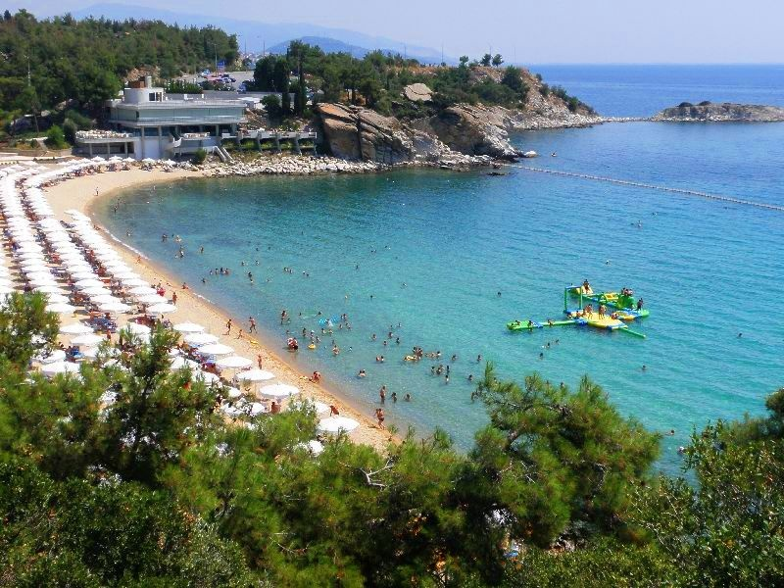
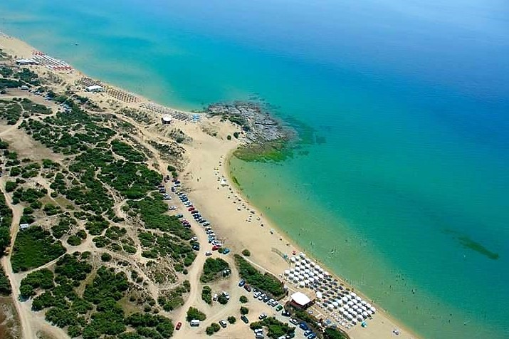
Batis Beach Ammolofi Beaches

Slide 14
What to eat
Fresh fish in Kavala Tip: Small fish and sea foods are delicious (Sardeles, Gavros, Calamari, Octopus etc.)
Greek Traditional cousine among others delicious foods like Mousakas, Yemista, Pastitsio etc.
Grilled Meat: Different steaks from pork veal lamp, Bifteki, Gyros, Souvlaki, Panseta, Paidakia etc.
What to drink
Local vines, ouzo, tsipouro, ouiski and Beer.
What to buy
The Famous Kourabiedes, honey, olives and oil from Thassos, mountain tea and herbs etc.

Slide 15
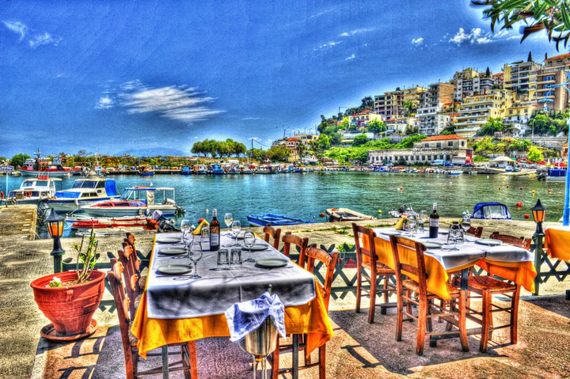
The End
Thank you

