Slide 1
LEARNING ABOUT SCHOOLS IN GREECE

Slide 2
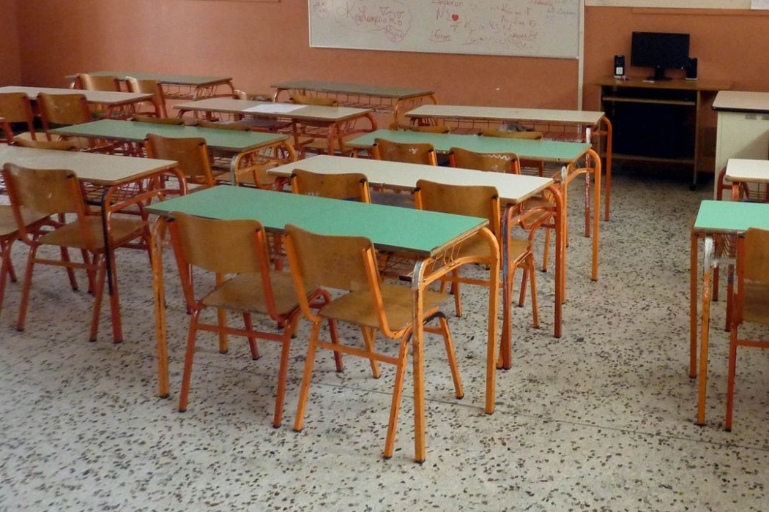
The educational system in Greece
The educational system in Greece is graduated in the following fields. The first field is supported by the kindergarten (one year) and the Primary school, which duration is six years. The second field of education is six years and it is also separated into junior high school(12-15 years old) and high school(15-18 years old).

Slide 3
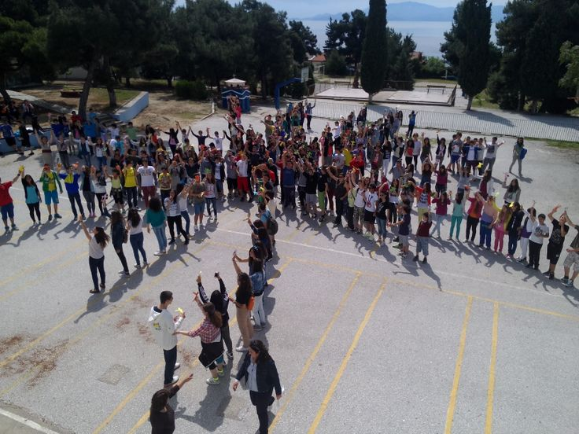
6th junior high school
Our school is located in a beautiful area, near a mountain. It has one main building, four smaller houses and three playgrounds.

Slide 4
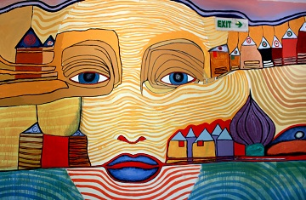
6th junior high school
It consists of 250 students and 25 teachers. There are also classes of special education for students with learning difficulties.

Slide 5
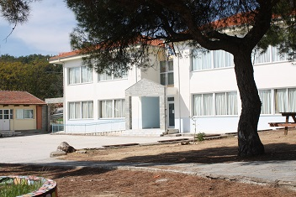
The main building
In the main building, there are two floors. In the first floor, there are four classrooms for the second grade. In the second, there are also four classrooms for the third grade.

Slide 6
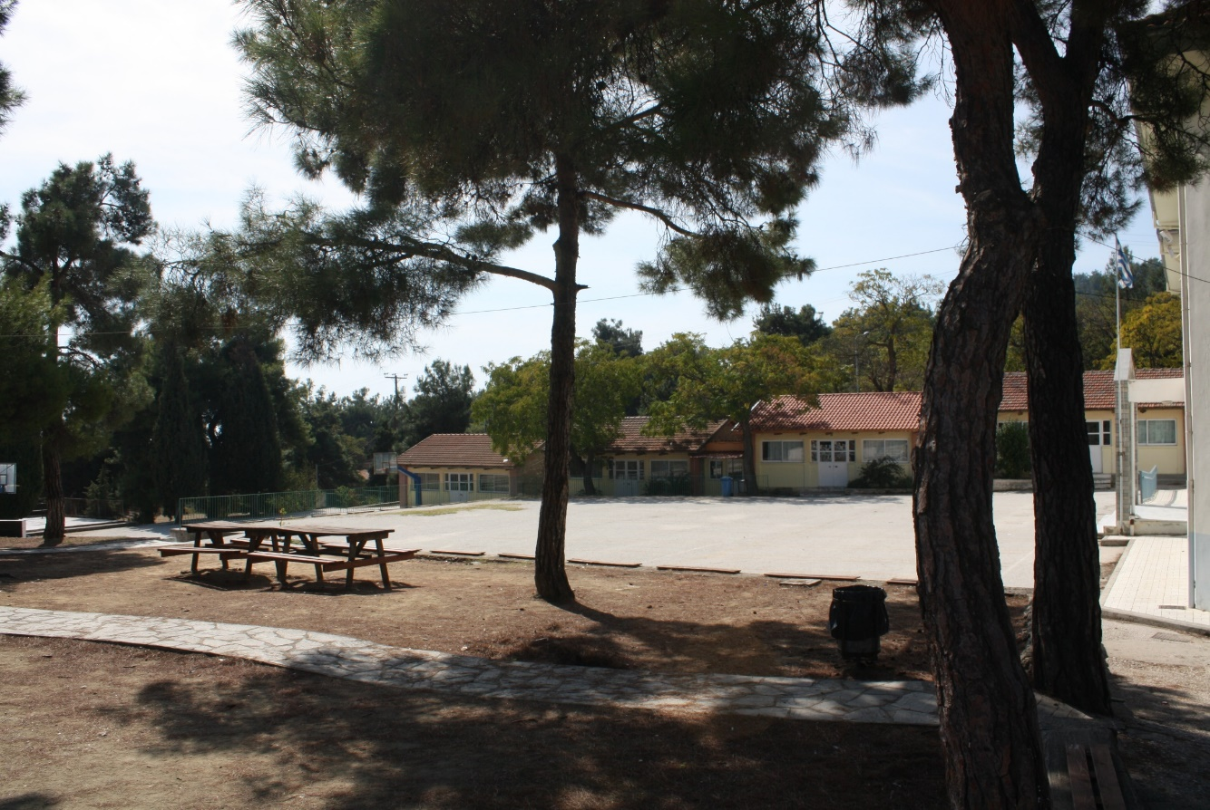
The small houses
The first grade is in the four small houses.

Slide 7
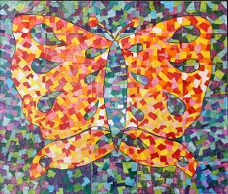
The classrooms for our activities
The physics lab
The music classroom
The computer classroom
The technology classroom
The gym
The French classroom

Slide 8
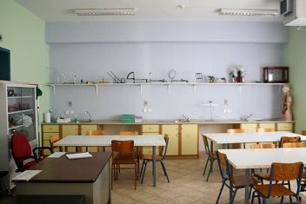
The physics lab
In this classroom, we learn about science. For instance, we make experiments.

Slide 9
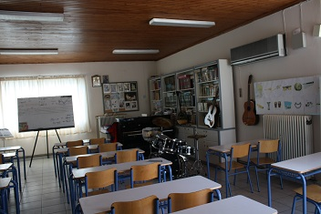
The music classroom
In this classroom, we learn about traditional songs for our country and how to sing.

Slide 10
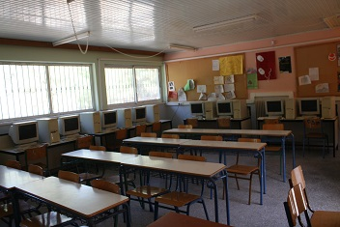
The computer classroom
In this classroom, we use computers and we learn about them.

Slide 11
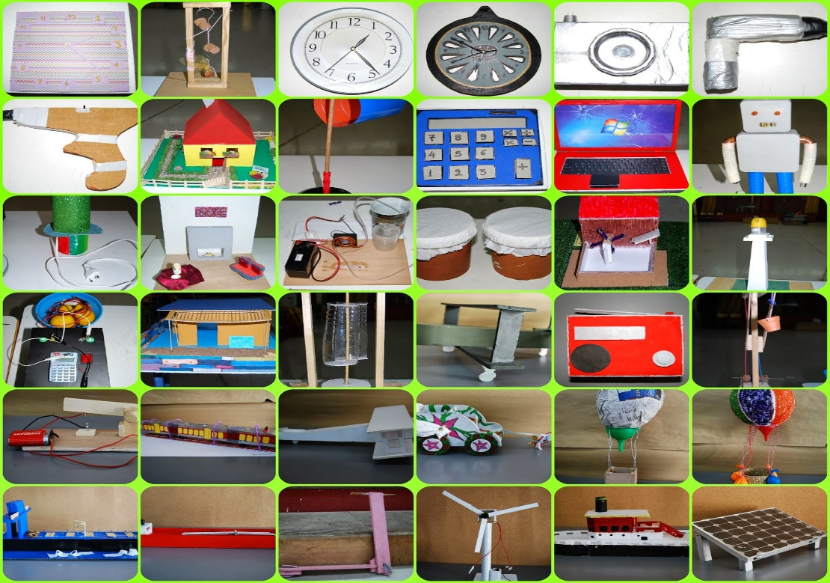
Technology classroom
In this classroom, we make constructions about different topics.

Slide 12
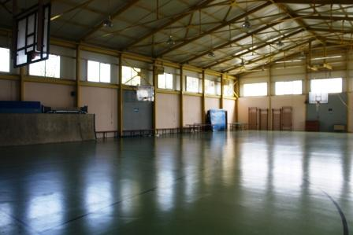
Our gym
In the gym, we do sports like basketball and volleyball. Furthermore, we play ping-pong and we dance traditional dances.

Slide 13
The school canteen

Slide 14
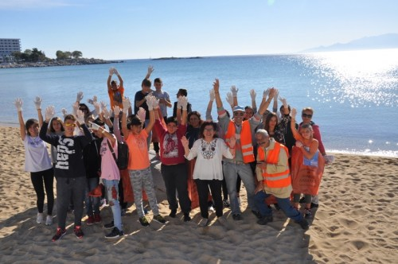
More information about our school
We are a big school. Οur school takes part in many competitions and many projects like cultural and environmental projects.

Slide 15
Our school above

Slide 16
THE END!!!
This is our school. Thanks for your attention…

